Slide 1
What Explains the Industrial Revolution in East Asia? Evidence From the Factor Markets
By CHANG-TAI HSIEH*

Slide 2
Introduction
Several recent growth accounting exercises have found that their extraordinary rate of output growth was due primarily to an equally impressive rate of factor accumulation, with little due to technological progress.
factor accumulation has been the lead actor in East Asia’s growth and the industrial revolution in East Asia can largely be explained as transition dynamics in a neoclassical growth framework.
The central point of this paper is that if the capital-output ratio in these countries has increased by the extent implied by their national accounts, the return to capital should have fallen dramatically as capital accumulation encounters diminishing returns.

Slide 3
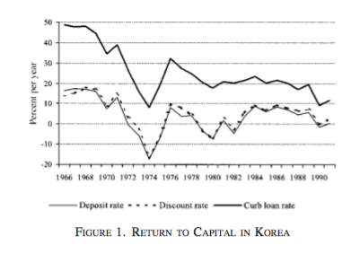
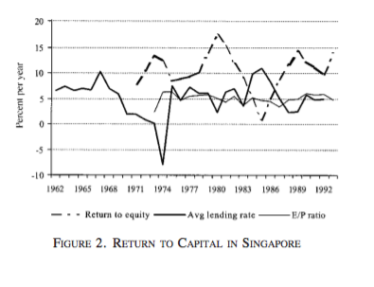
Figure 1 plots three alternative measures of the marginal product of capital in Korea. All three measures indicate that the marginal product of capital has fallen dramatically since the 1960’s. In the case of Singapore, however, it is highly unlikely that the return to capital in Singapore has fallen by the magnitude indicated by the national accounts

Slide 4
Introduction
Problem: the task of computing reliable national income statistics is an impossibly difficult one and that, even under the best circumstances, such statistics are riddled with large errors.
As one solution to this problem, this paper presents price-based (dual) estimates of TFPG (total factor productivity growth)that do not rely on data from the national account.
These price-based estimates should be identical to the primal estimates as long as the factor price data are consistent with data from the national accounts.

Slide 5
Introduction
In the case of Korea for example, the paper shows that the dual estimates of TFPG are very similar to the primal estimates since the alternative measures of the rental rate in Korea have fallen by roughly the same magnitude as that indicated by the national accounts.
In contrast, the dual estimates of TFPG in Singapore are significantly higher than the primal estimates because the rental rate has remained roughly constant despite the sharp increase in the capital-output ratio indicated by the national accounts.

Slide 6
content
The Dual Approach to Growth Accounting
Measuring Factor Prices and Factor Shares
Dual Estimates of TFPG
Has the Return to Capital in Singapore Fallen?
Errors in the National Accounts
Conclusion

Slide 7
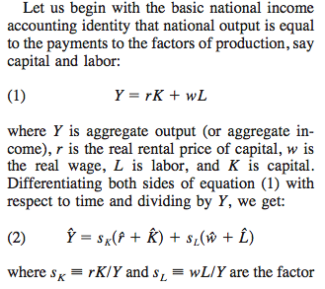
The Dual Approach to Growth Accounting

Slide 8
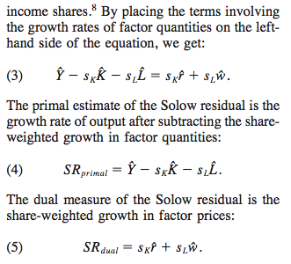
The Dual Approach to Growth Accounting

Slide 9
The Dual Approach to Growth Accounting
Hence, with only the condition that output equals factor incomes, we have the result that the primal and dual measures of the Solow residual are equal. No other assumptions are needed for this result
As long as the data on factor prices are consistent with those from the national accounts the two sets of TFPG estimates will be the same as long as the growth rate of the capital share is equal to that of the profit share.
Therefore, any difference between the dual and primal estimates of TFPG is probably not due to imperfect competition or omitted factors of production, but rather due to inconsistencies between the data from the national accounts and the factor price data.

Slide 10
II. Measuring Factor Prices and Factor Shares
The dual rate of TFPG is calculated as a weighted average of the growth rate of different types of capital goods and wages of different types of workers, where the weights are the shares of payments to each factor.
Real wages of workers are differentiated by sex and by educational attainment (from four to six educational categories, depending on the country) computed from household surveys and the population censuses in the four countries.

Slide 11

II. Measuring Factor Prices and Factor Shares
Turning to the rental price of capital, I calculate the rental price of five categories of capital goods: residential buildings, nonresidential buildings, other construction, transport equipment, and machinery equipment.
where pkj /p is the relative price, pˆk the inflation rate, and δjthe depreciation rate of type j capital, and i is the nominal interest rate. This equation states that the rental rate of capital good j is equal to the product of its relative price and the real interest rate plus the depreciation rate.

Slide 12
II. Measuring Factor Prices and Factor Shares
To calculate the real rental price of each capital good j, I need estimates of the relative price of capital ( pkj /p), the depreciation rate (δj), and the real interest rate (i - pˆk ).
Estimates of real interest rates to calculate the real rental price of capital. I use two methods to do this. One approach is to assume that all assets earn the same nominal return and subtract the rate of asset price inflation from this nominal rate. Another approach is to use a market-determined real rate of return such as the earnings-price (E-P) ratio.

Slide 13
factor shares
share of payments to different types of worker (again, differentiated by sex and education) is calculated as the product of the average wage and the number of workers in each category divided by total payments to labor.
To estimate the share of payments of each type of capital, I take the product of the nominal rental price of capital and the estimated capital stock and divide by the total payments to capital.

Slide 14
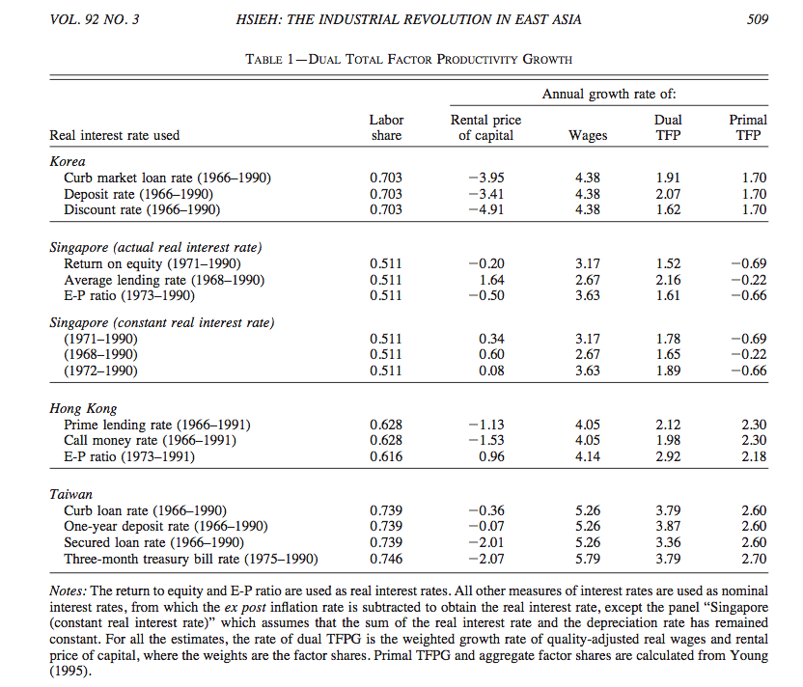
III. Dual Estimates of TFPG

Slide 15
III. Dual Estimates of TFPG
While the dual estimates of TFPG for Korea and Hong Kong are similar to the primal estimates, they exceed the primal estimates by 1 percent a year for Taiwan and by more than 2 percent for Singapore.
The reason for the large discrepancy for Singapore is because the return to capital das not fallen. despite the high rate of capital accumulation indicated by Singapore’s national accounts.
In contrast to Singapore, the discrepancy between the dual and primal estimates of TFPG in Taiwan is not due to differences between the measures of the rental price of capital shown in Table 1 and that implied by national accounts. Marginal product of capital fell from 1966 to 1990, which corroborates the data from the national accounts that indicate an increase in the capital-output ratio over the same time period. Instead, the gap between the two measures of TFPG is entirely due to an inconsistency between the growth rate of real wages computed from household surveys in Taiwan and that implied by the national accounts.

Slide 16
IV. Has the Return to Capital in Singapore Fallen
The large gap between the dual and primal estimates of TFPG for Singapore is due to this inconsistency between the national accounts and the estimates of the rental rate.
this section considers four reasons for why the estimates of the rental rate of capital used in the dual estimates may not be good estimates of the marginal product of capital in Singapore.

Slide 17
A . Taxes on Capital
the critical question is whether the tax rate on aggregate capital has fallen over the last few decades
If taxes on capital have steadily fallen, then the share of revenues from capital taxation should also have fallen. Instead , the share of revenues from taxes on capital has increased.
However, the fact that the average tax rate on aggregate capital has increased significantly since the late 1960’ s makes it more unlikely that the marginal tax rate on capital has fallen by enough to explain the discrepancy between the return to capital implied by the national accounts and the market- based measures of the return to capital.

Slide 18
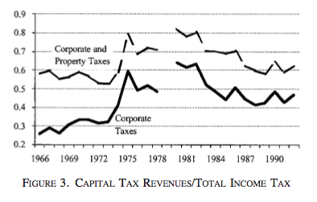
A . Taxes on Capital

Slide 19
B . Stalinist Forced Investment
This section presents evidence to show that although the government controls a large share of national savings, these funds have largely been used to build up large holdings of foreign assets, and have not been channeled into public investment.

Slide 20

Even if is S_{PUBLIC} large ,it does not follow that I_{PUBLIC} must be large because the government can invest the saving under its control in other types of asset.

Slide 21
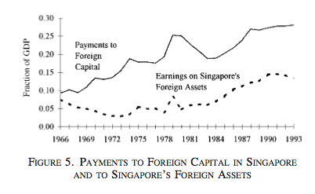

Slide 22
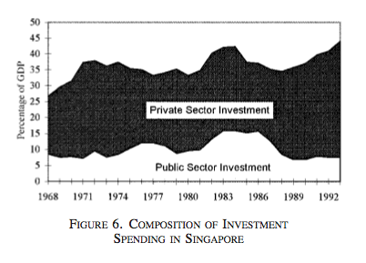

Slide 23
C. Changes in the Risk Premium
there was a large risk premium in Singapore in the late 1960’ s and early 1970’ s that has subsequently fallen.
one way to measure risk premium is to use a measure of the return to capital that already incorporates a risk premium.
Another way to measure the risk premium in Singapore is to look at the interest rate paid on US-dollar denominated bonds issued by the Singaporean government in the early 1970’ s.

Slide 24
C. Changes in the Risk Premium
In the late 1980’ s, Singapore’ s long-term sovereign foreign currency debt was rated Aa3 by Moody’s and AA+ by Standard and Poors, which implies a sovereign risk premium of 100–110 basis points.
An 85–95- basis points drop in the sovereign risk premium over two decades implies that the average annual growth rate of the rental price of capital is 0.21–0.23 percent lower than what the estimates in this paper indicate . In turn, with a capital share of 50 percent, this implies that the estimates of dual TFPG presented in this paper are upwardly biased by 0.11–0.12 percent a year, which is relatively small.

Slide 25
D. Financial Market Controls
One of the measures to estimate real interest rate is the average lending rate of commercial banks in Singapore.
A potential problem with the average lending rate is that these rates were regulated by a bank cartel until the cartel was disbanded in the early 1970’s. According to this argument, lending rates were kept below their equilibrium levels in the late 1960’s by ceilings on lending rates. However, after these controls were lifted in the 1970’s, lending rates rose to their equilibrium levels. Therefore, the end of the bank cartel in the 1970’s could have masked the fall in the marginal product of capital.
Furthermore, If the bank cartel’s minimum lending rates prevented banks from offering lower rates to some of their customers, the average lending rate in the late 1960’s would have been higher than their market-clearing rates. Therefore, if the cartel’s controls on lending rates had any effect, the estimated rental rate of capital based on the average lending rate would overstate, not understate, the fall in the marginal product of capital.

Slide 26
V. Errors in the National Accounts
It is difficult to see how all three estimates of the rental rate in Singapore could have remained constant over the last few decades if in fact the marginal product of capital has fallen sharply.
The natural explanation for this discrepancy is that Singapore’s national accounts have overstated the amount of investment spending.
In fact, Goh-Keng Swee, has suggested that investment expenditures in Sin- gapore are overstated.

Slide 27
V. Errors in the National Accounts
The more general point is that there are idiosyncrasies in how every government compiles their national accounts that make cross-country comparisons problematic.
While official statistics indicate that the rental value of residential housing in Singapore is much lower than in Hong Kong, they also indicate that Singapore has invested significantly more resources (8 to 10 percent of GDP) into housing than Hong Kong (about 4 percent of GDP) (see Figure 8). This translates into large differences in the average quality of housing between Hong Kong and Singapore.

Slide 28
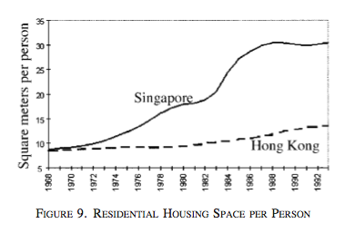
V. Errors in the National Accounts

Slide 29
V. Errors in the National Accounts
Since the task of learning the intricacies of national in- come accounting for every country is prohibitively time consuming, the dual approach provides a way to bring alternative data to bear to check the consistency of data from a coun- try’s national accounts.

Slide 30
Conclusion
The advantage of using the dual estimate:
(1).factor prices, primarily wages and interest rates, are observed as an equilibrium outcome in a marketplace.
(2).using data on prices instead of quantities
In the case of Korea, the dual TFPG estimates are remarkably similar to the primal estimates. Where the dual and primal estimates differ, and dramatically so, is for Singapore.

Slide 31
conclusion
Standard estimates of primal TFPG
Dual estimates of TFPG
Increase in return to capital has increase
no technological progress
all of the increase in standards of living has been due to factor accumulation, primarily capital accumulation
increase in real
technological progress has played as important a role in Singapore’s growth as that in the other East Asian countries.

